Slide 1
Ruksana kabir P.A
214415@ust-global.com

Slide 2
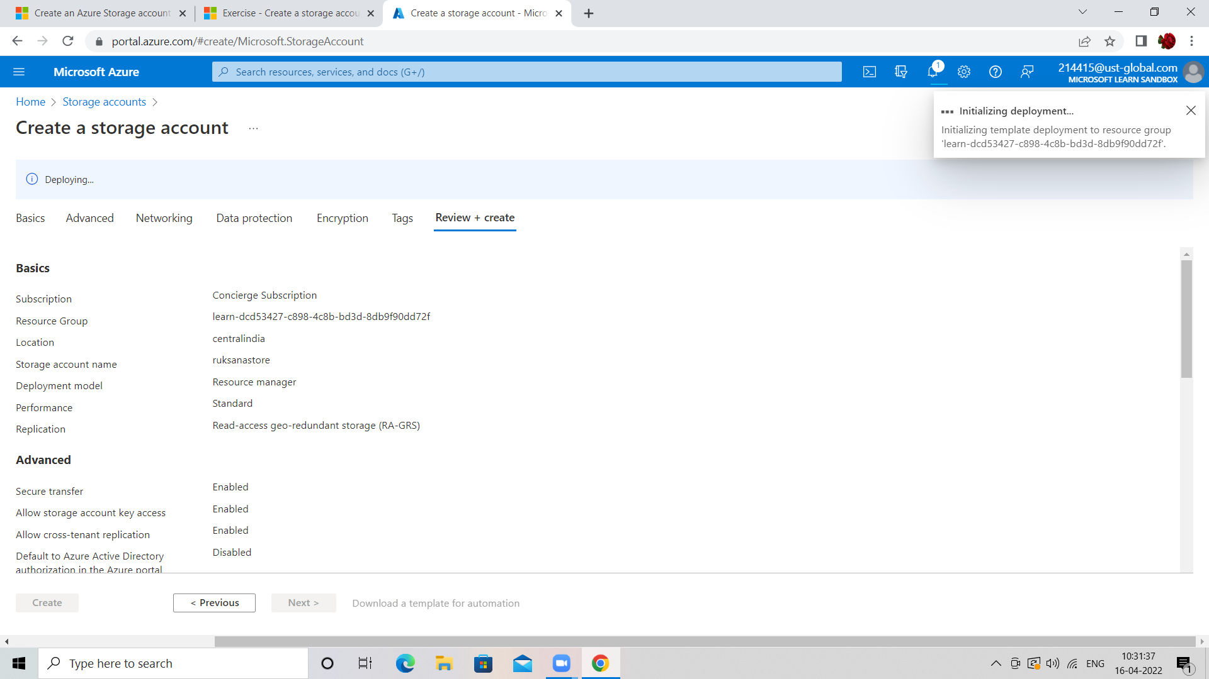
Creating storage account

Slide 3
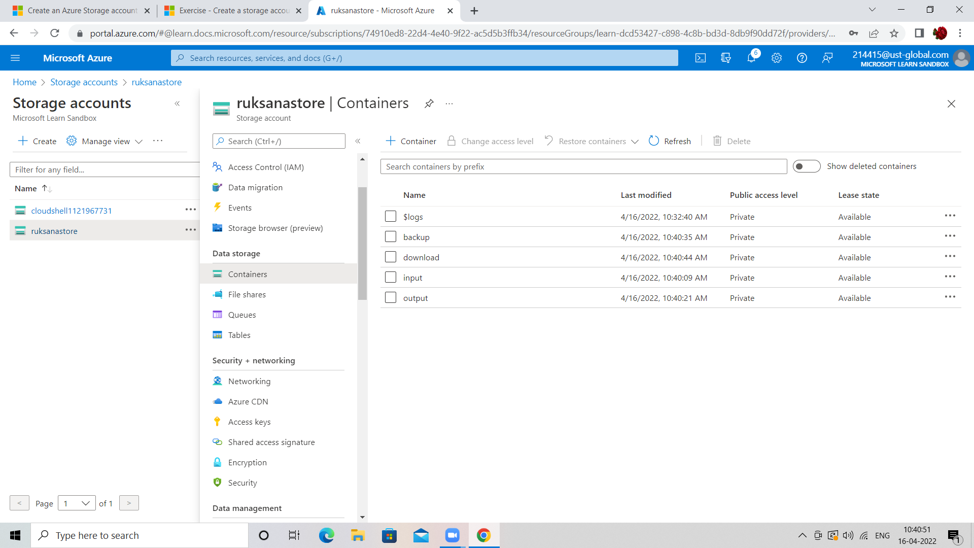
Azure containers

Slide 4
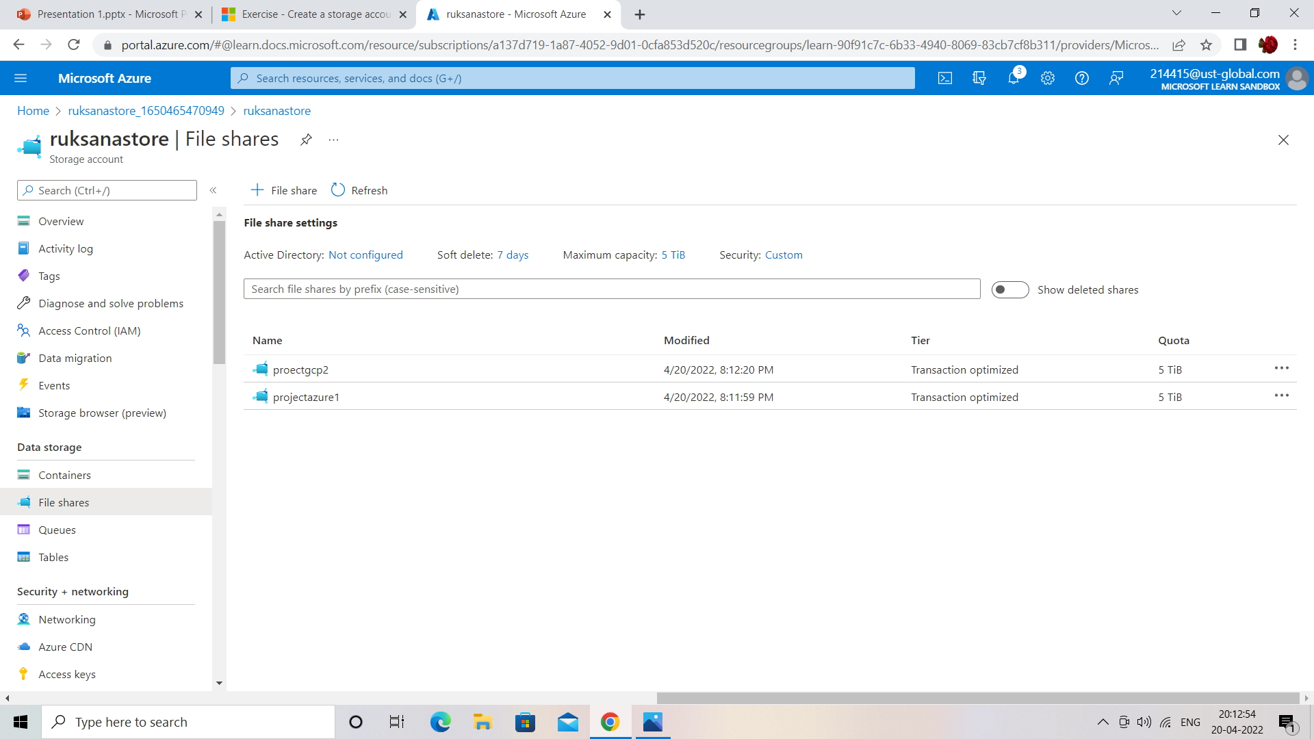
Fileshare with two directories

Slide 5
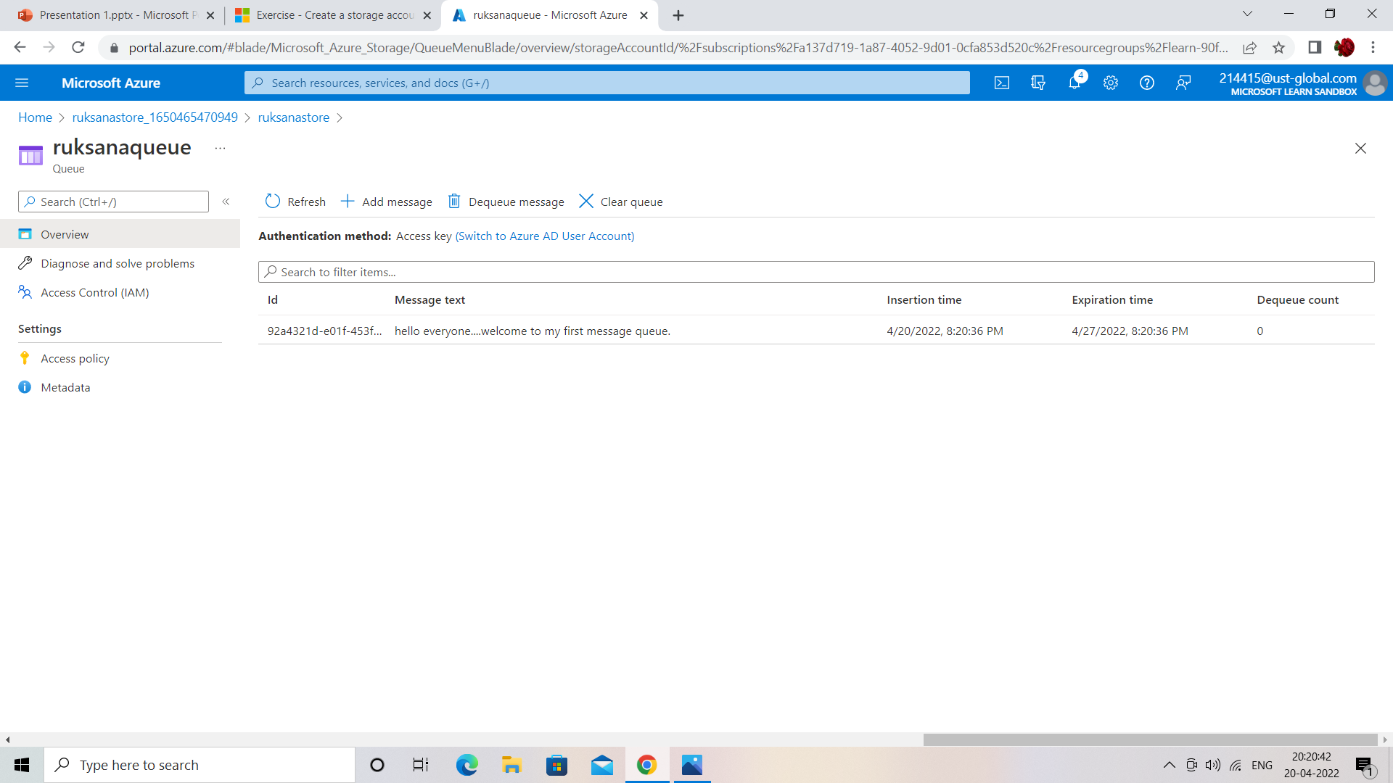
Message queue with a message

Slide 6
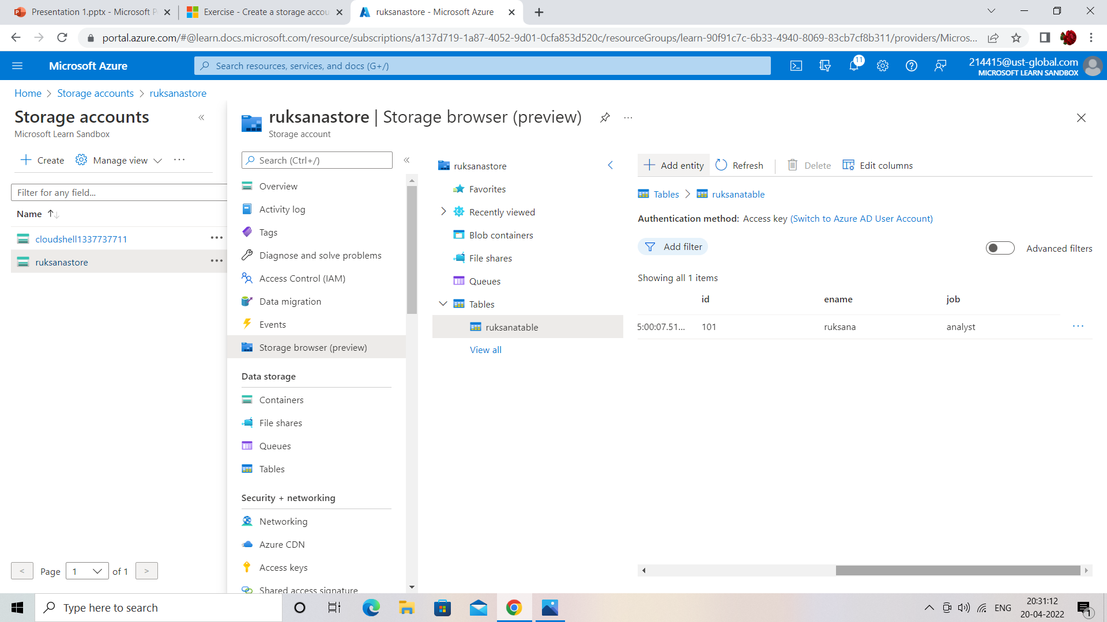
Table in azure.

Slide 7
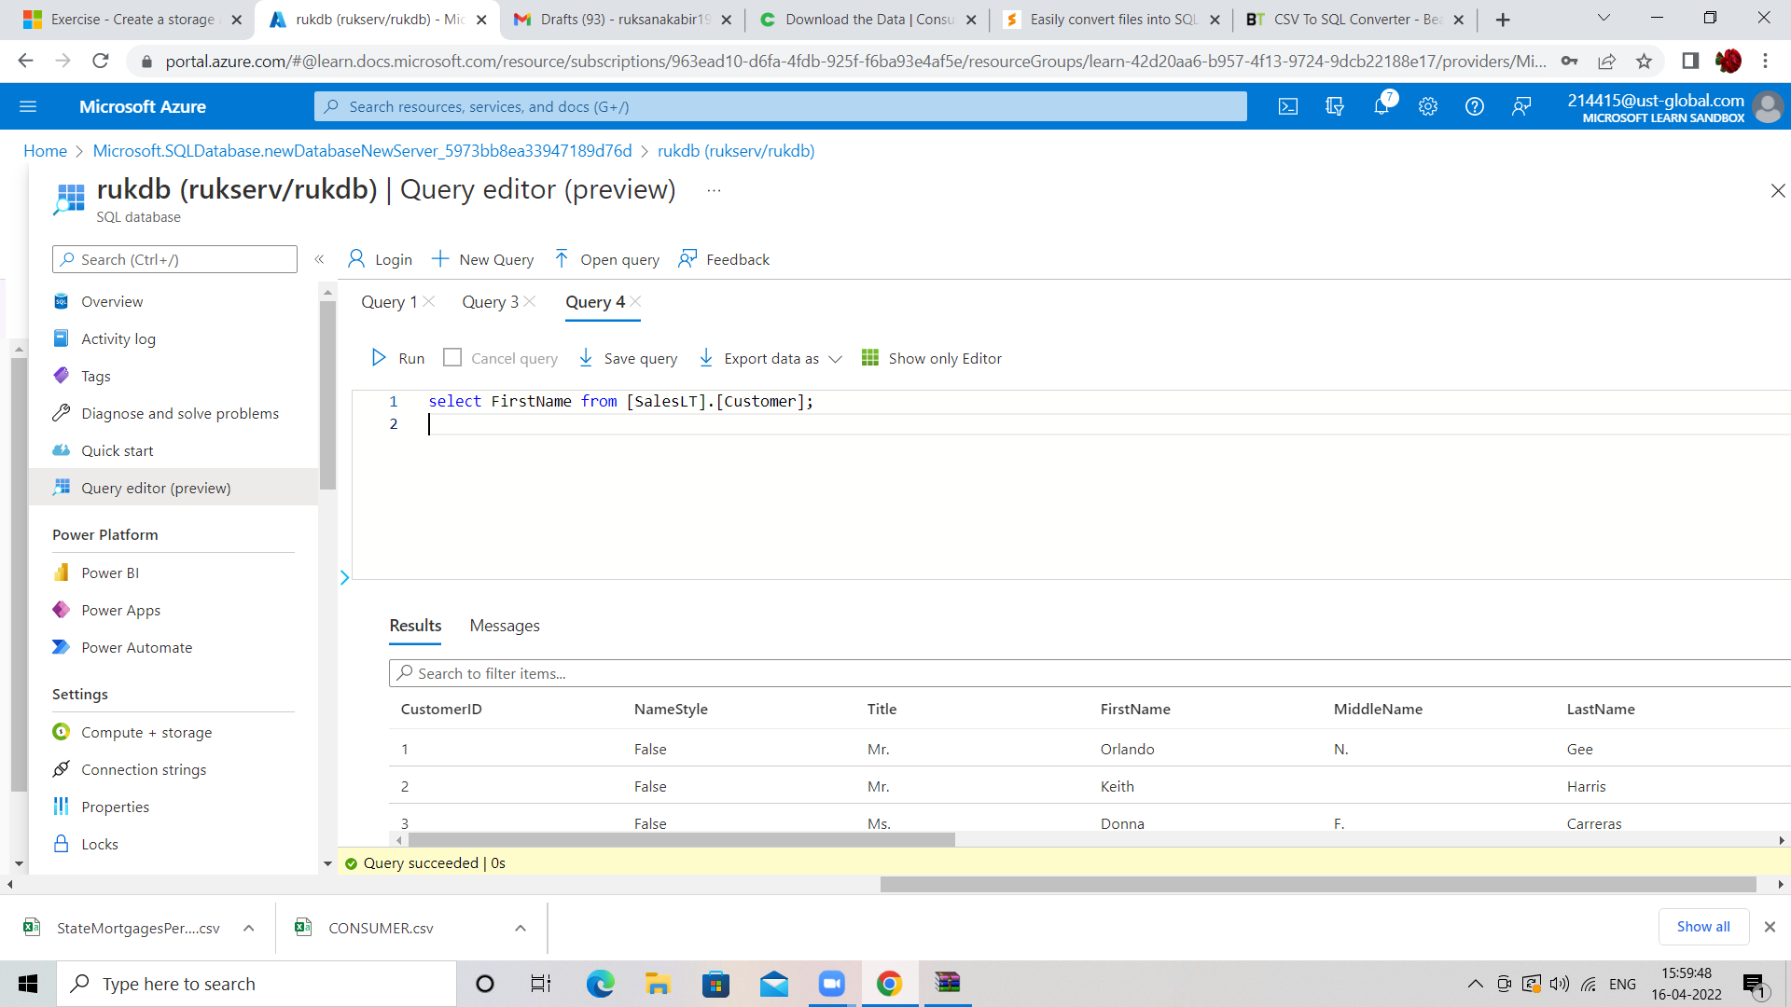
Sample database with a query

Slide 8
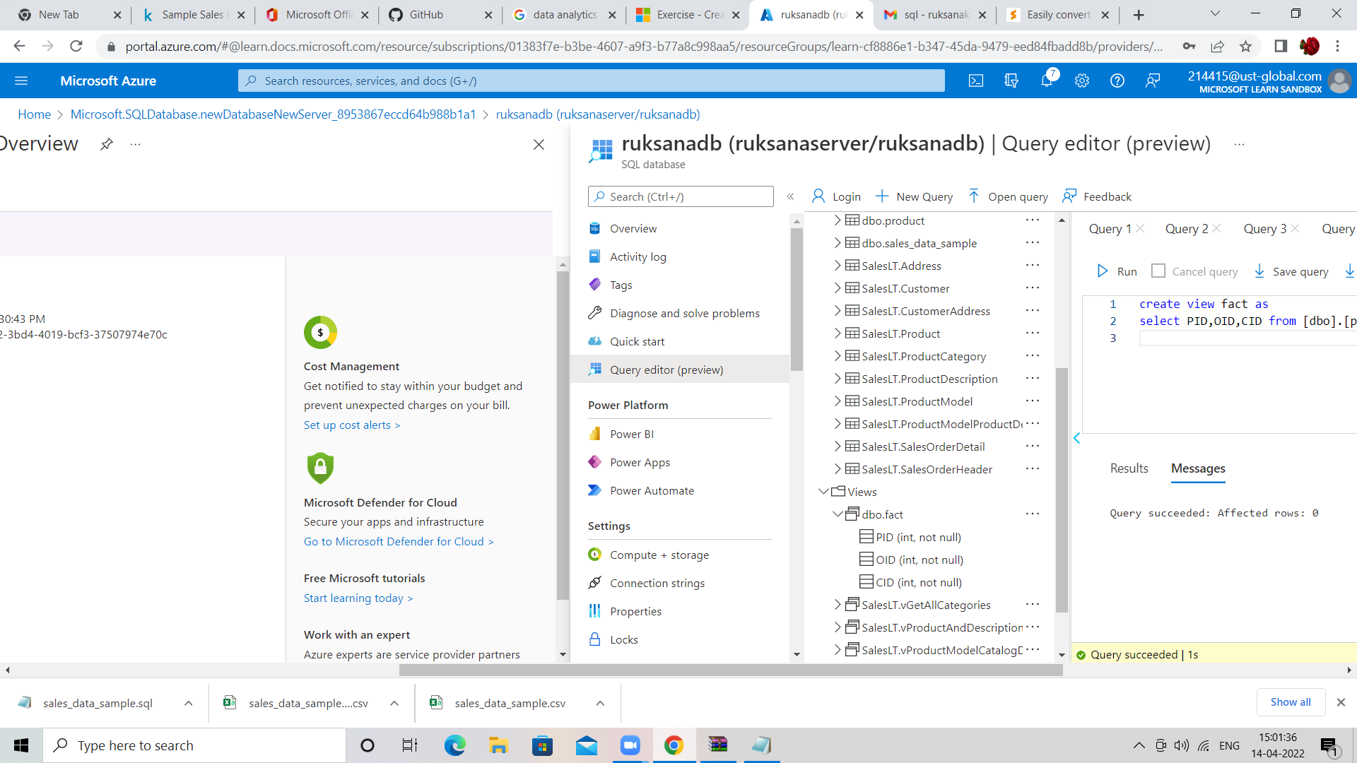
Estimate the unit sales of retail goods

Slide 9
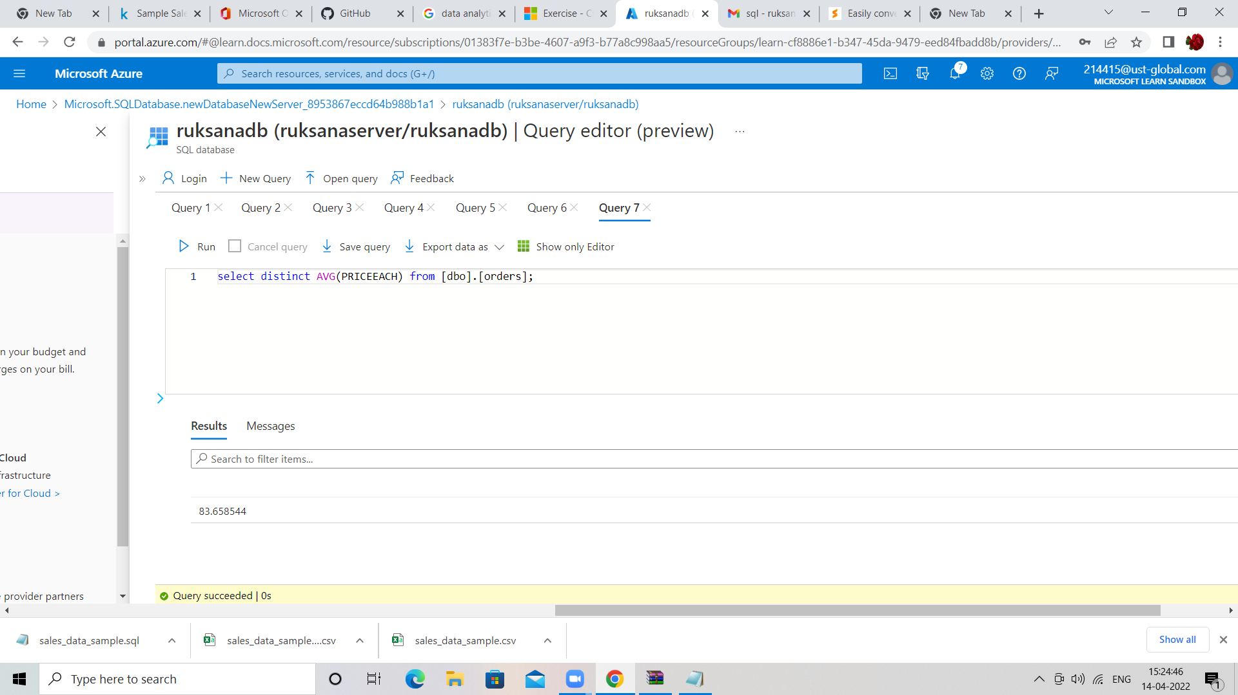

Slide 10
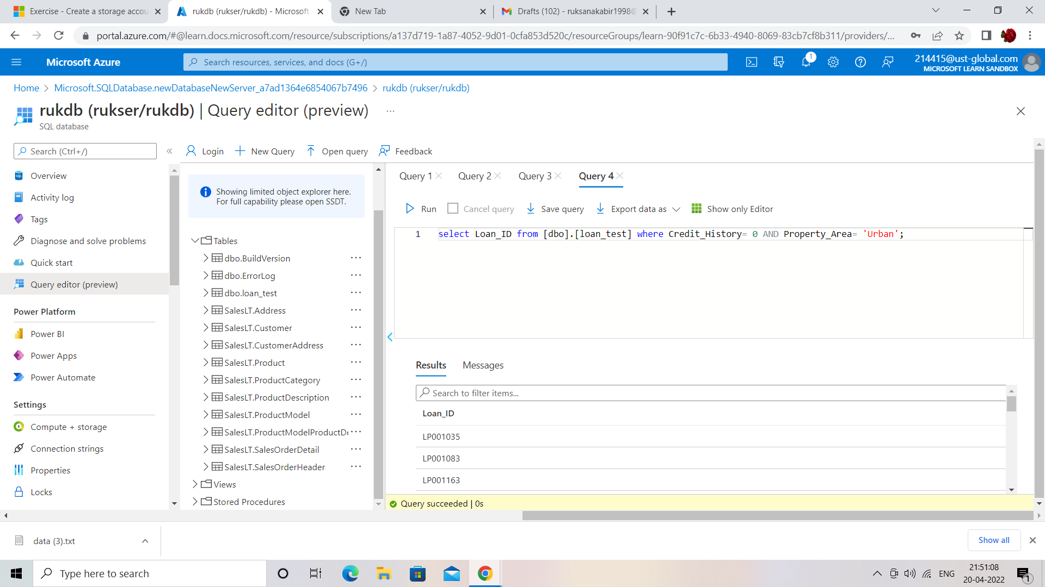
Financial need programs for consumer loan products

